Slide 1



A 21st-Century Census Curated Data Enterprise
Analysis of Resilience Indicators
and
Review of State Constitutions
Vicki Lancaster and Stephanie Shipp
May 31, 2023

Slide 2
Introducing the Curated Data Enterprise
We are moving towards a single enterprise, data-centric operation that enables us to funnel data from many sources in a single data lake using common collection and ingestion platforms ... This is the essence of a curated data approach — assemble, assess and fill in the gaps to create quality statistical data.
Robert Santos, Director, U.S. Census Bureau
CURATED DATA
ENTERPRISE
The Census Bureau of the Future
Both an infrastructure and a continuously evolving ambition to empower and enable Bureau scientists and their data users to develop new measures of people, places, and the economy.
Exploits multiple data sources, from sample surveys, censuses, and other official administrative and third-party data, which can provide more robust, timely, and comprehensive measures when combined.
Notes:
Background
We are collaborating with the US Census Bureau to develop a new approach to creating data products, called a Statistical Products First, that can result in new and better measures of America’s people, places, and the economy. We are helping to develop the Curated Data Enterprise (CDE) that will provide the infrastructure to enable Census Bureau scientists and their data users to progress from a focus on individual data elements or surveys items to one focused on the purpose and use of the information.

Slide 3

Flipping the Focus
Determine what information stakeholders need to reach their objectives
From there, shape the statistical products to be developed

Slide 4

Statistical Product First Approach
Shifting the Paradigm

Slide 5



















What are some purposes and uses?
Creating products to meet data user needs
Equity and Inclusion
Counting Children
Family Units
Rural Communities
Local Businesses
Tribal Areas
Vulnerable Populations
Elderly Residential Care
The Unhoused
Migration
Climate Change
Gig Economy
Workforce Automation
Differential Undercount
Broadband Deployment
Emergency Preparedness
Economic Mobility
Commuting Patterns
Changing Demographics

Slide 6
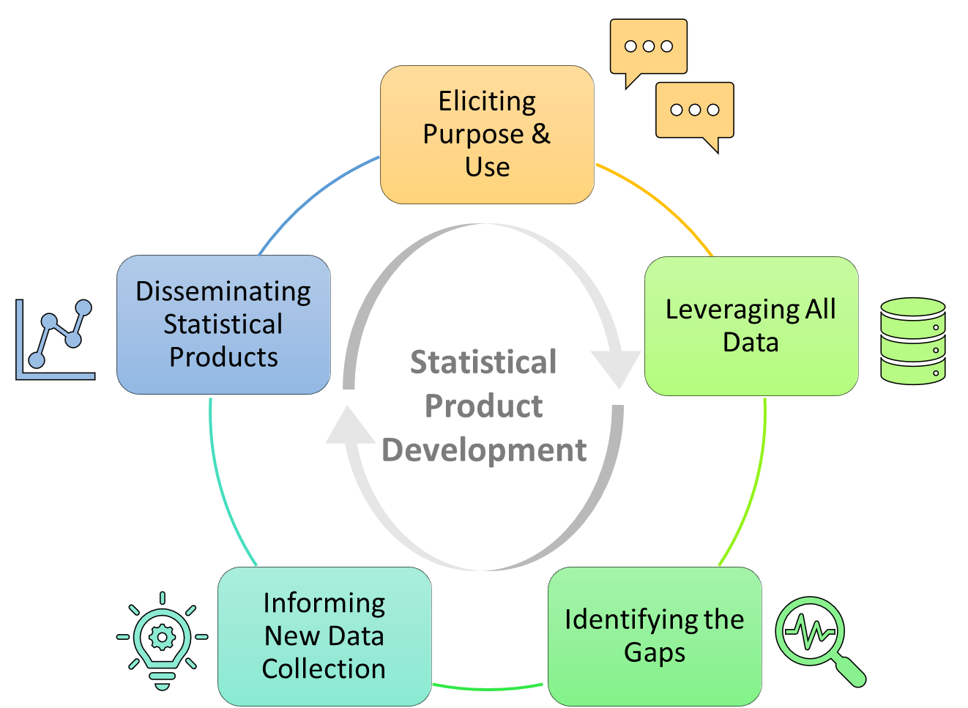
The Continuous Journey Ahead

Slide 7

Purpose and Use: Data Needs in State Constitutions
State governments have many purposes and uses for federal statistical data.
What are major purposes the statistical products need to support?
What would add value to their statistical products?
What modalities of statistical product dissemination support their data user needs?
Notes:
State governments have many purposes and uses for federal statistical data. The Census Bureau would like to address these needs by creating tools to facilitate data access at all levels of data acumen, i.e., from very basic users to sophisticated data users. This project will entail a review of the 50+ state constitutions to understand these needs.

Slide 8

Tasks: Identify Data Needs in State Constitutions
Create your review process
Create inventory of state constitutions, cross checking that it is the latest version of the constitution.
Each team member read one state constitution:
Does the constitution mention the use of data? Does it mention specific data sources, e.g., U.S. Census Bureau data or other specific sources?
What is the context for the data needs? Describe and copy or summarize the parts of the constitution that mention data needs and data sources.
Based on the review of one constitution, what are your ideas for conducting this study?
Based on the individual reading of a state constitution, meet as a team to discuss and agree on an approach to review.
Develop process for cross-checking work.
Design a way summarize your findings
Construct a type of data visualization (e.g., dashboard) to display and share your findings. Findings can be displayed using word clouds and interactive maps, etc.
Notes:
1. Create your review process
Create inventory of state constitutions, cross checking that it is the latest version of the constitution.
Each team member read one state constitution:
Does the constitution mention the use of data? Does it mention specific data sources, e.g., U.S. Census Bureau data or other specific sources?
What is the context for the data needs? Describe and copy or summarize the parts of the constitution that mention data needs and data sources.
Based on the review of one constitution, what are your ideas for conducting this study?
Based on the individual reading of a state constitution, meet as a team to discuss and agree on an approach to review.
Develop process for cross-checking work.
2. Design a way present to your findings
Construct a type of data visualization (e.g., dashboard) to display and share your findings. Findings can be displayed using word clouds and interactive maps, etc.

Slide 9
Community Resilience in the Face of Climate Change
How does this fit with Stephanie’s presentation of the Curated Date Enterprise?
How good are community resilience indices?
Emergency Preparedness
Notes:
FEMA, EPA, CENSUS all have resilience indices
We not really coming up with a new product – but are evaluating existing statistical products

Slide 10
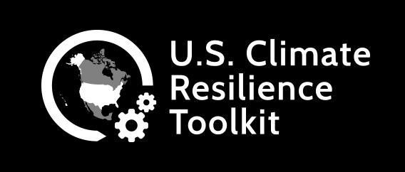
Community Resilience in the Face of Climate Change
What is Community Resilience?
Community resilience is the capacity of individuals, households, and communities to absorb the stresses from a disaster and recover.
A community resilience index be sensitive to changes in the natural environment, built environment, governance, and social structure and vulnerability/risk to climate events.
https://toolkit.climate.gov/#steps
Notes:
Example of the Destruction of the natural Environment - The Mississippi River Gulf Outlet (MRGO) is a 76-mile long artificial channel that was constructed to provide a shorter navigation route between the Gulf of Mexico and the Port of New Orleans. Authorized by Congress in 1956 and completed by the U.S. Army Corps of Engineers in 1968, the MRGO originally was 650 feet wide at the top and at least 36 feet deep. More earth was dredged to construct the MRGO than was moved to construct the Panama Canal!

Slide 11
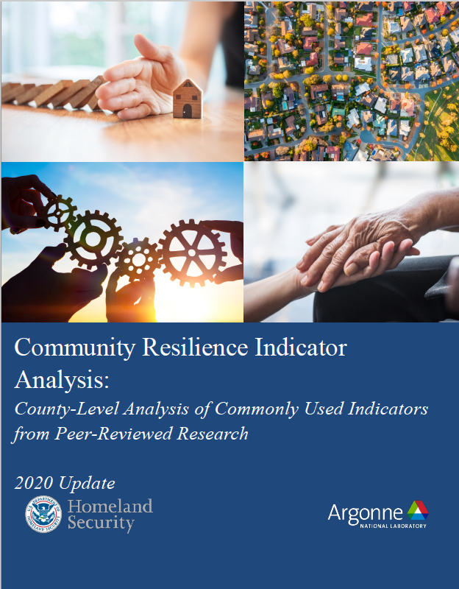
Community Resilience in the Face of Climate Change
There are a lot of community resilience indices - 73 were identified and reviewed by Argonne National Laboratory under a contract from Homeland Security.
The goal was to “provide a data-driven basis to prioritize locations for TA (i.e., Technical Assistance) investment and to inform community resilience....”
https://www.fema.gov/sites/default/files/documents/fema_2022-community-resilience-indicator-analysis.pdf

Slide 12
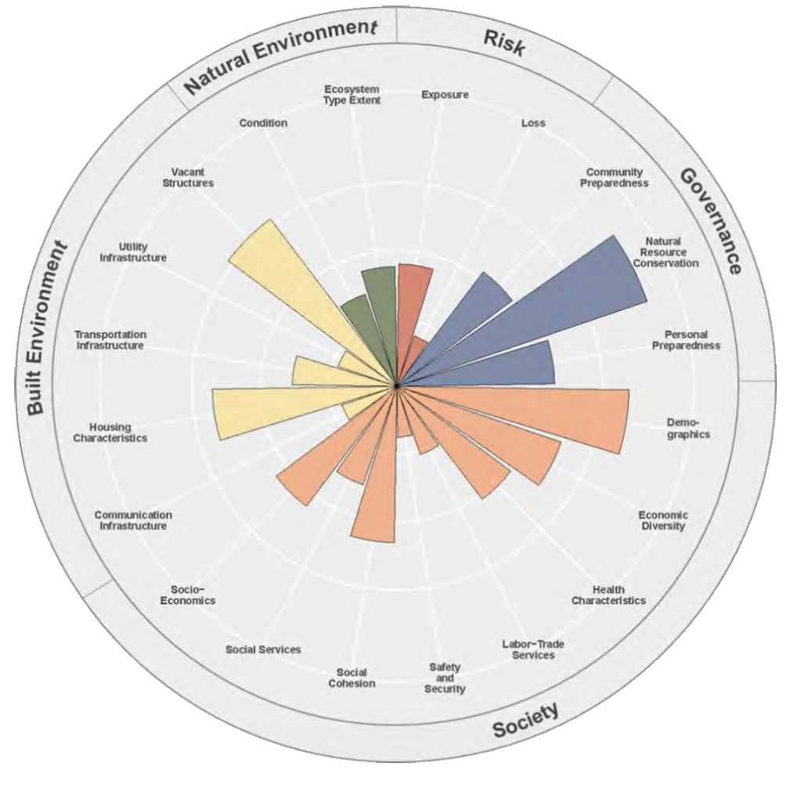
Community Resilience in the Face of Climate Change
We are going to use the 20 indicators identified by the Climate Resilience Screening Index (CRSI) framework to evaluate other community resilience indices.
Polar plot where the length of the bars corresponds to the indicator score (variables). Within a domain, the higher indicator scores show a greater contribution to the domain score (sum of indicator scores).
https://cfpub.epa.gov/si/si_public_file_download.cfm?p_download_id=543576&Lab=CEMM

Slide 13
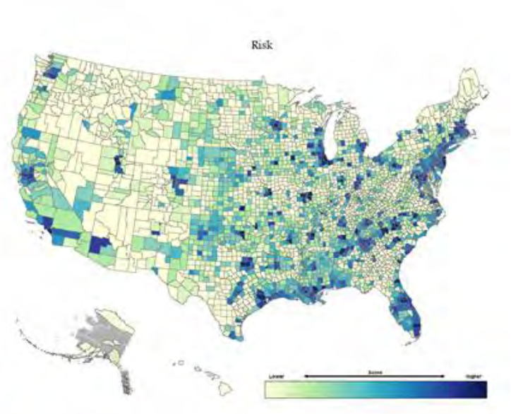
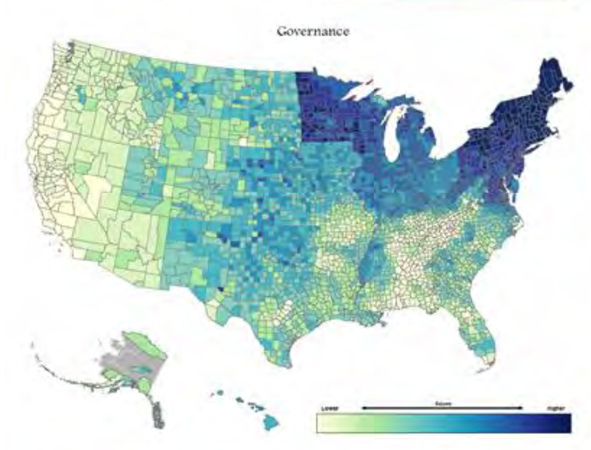
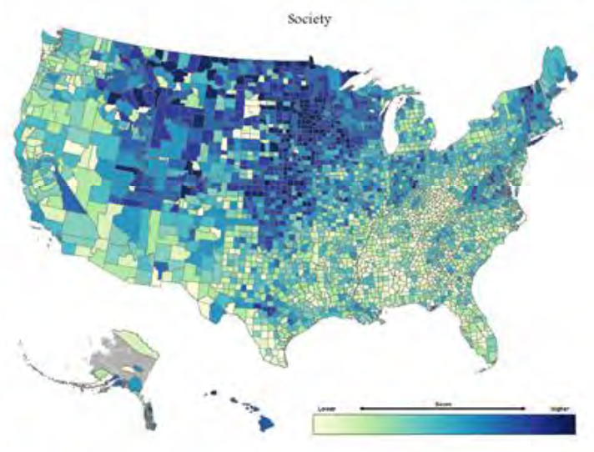
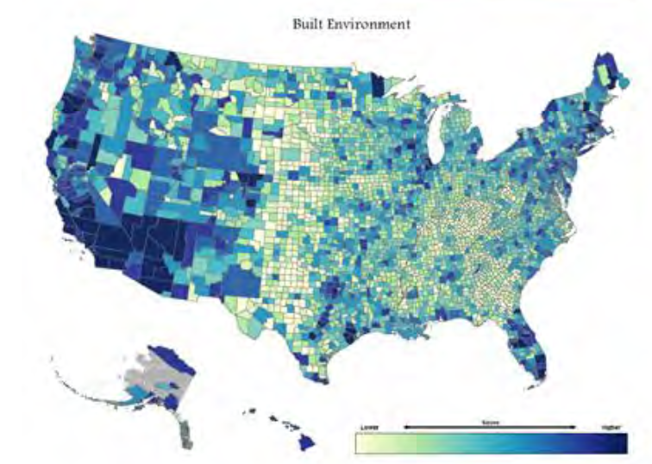
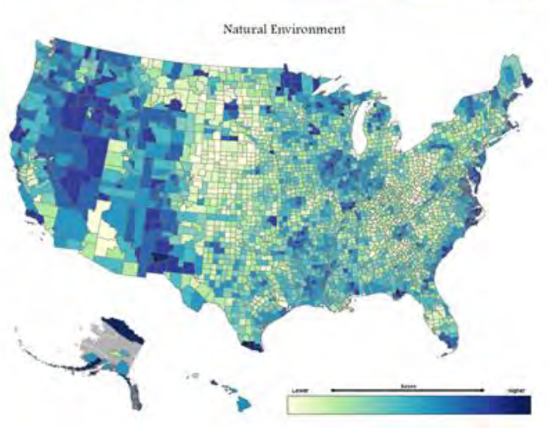
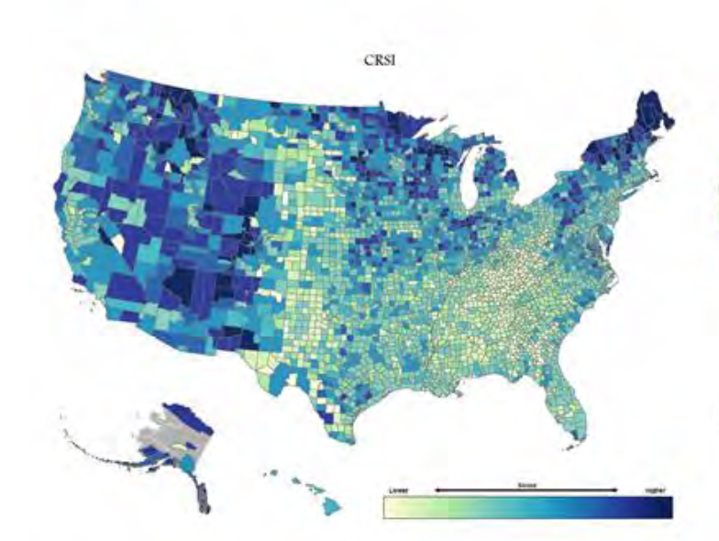
Community Resilience in the Face of Climate Change
ENVIRONMENT
RISK
GOVERANCE
SOCIETY
BUILT
NATURAL
COMMUNITY RESILIENCE
SCREENING INDEX
(CRSI)
https://cfpub.epa.gov/si/si_public_file_download.cfm?p_download_id=543576&Lab=CEMM

Slide 14
Community Resilience in the Face of Climate Change
Primary research question: Summer et al. (2017) provide a holistic measure of community resilience, Cumulative Resilience Screening Index (CSRI), that correctly identifies a county or city’s resilience to real-world natural hazard events (Summer et al., 2022a). We will use their method, observational verification (Thackery, 2014), to answer the question, do other resilience indices correctly identify the most and least resilient counties and cities under real-world natural hazard events?

